Slide 1
DYNAMIC SYSTEMS PRACTIONERS
UKZN Eye-care clinic INFORMATION MANAGEMENT SYSTEM

Slide 2
CLIENT BACKGROUND
University of KwaZulu Natal Discipline of Optometry
Westville Block E5
Offers Comprehensive Vision Assessment to the Community and internal stuff and students
Administrator: Priscillar Sewamber
Telephone Number: 031 260 7294

Slide 3
CURRENT SYSTEM OVERVIEW & PROBLEM IDENTIFICATION
The Eye-Care clinic uses a manual system to record appointment bookings, registering patients and keeping records for patients.
Manual patient data management is labour demanding and time consuming.
There is limited space to update patient information using manual record card.
Patent files may be lost due to natural hazards.
Using manual filling system exposes patient data to high security issues.

Slide 4
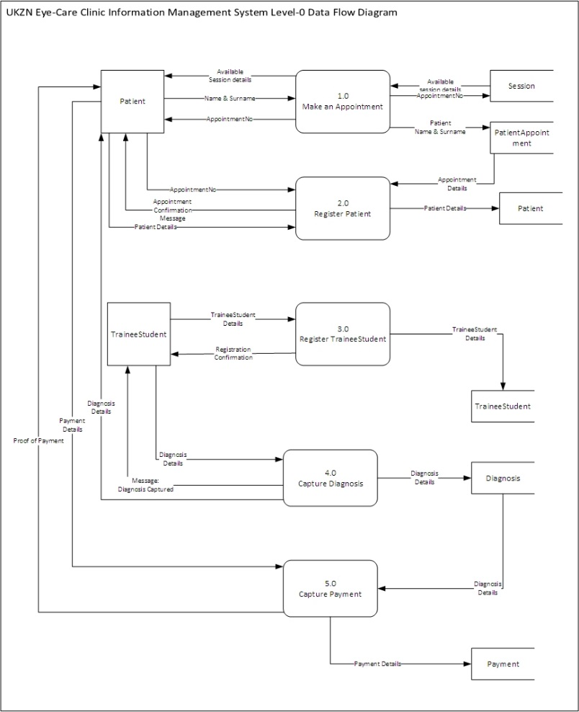
DATA FLOW DIAGRAM

Slide 5
MAJOR SYSTEM’S REQUIREMENTS
The UKZN Eye-Care Clinic Information is Required to do the following:
Make appointment Booking
Register patient
Register Trainee Student
Capture Diagnosis Details
Capture Payment

Slide 6
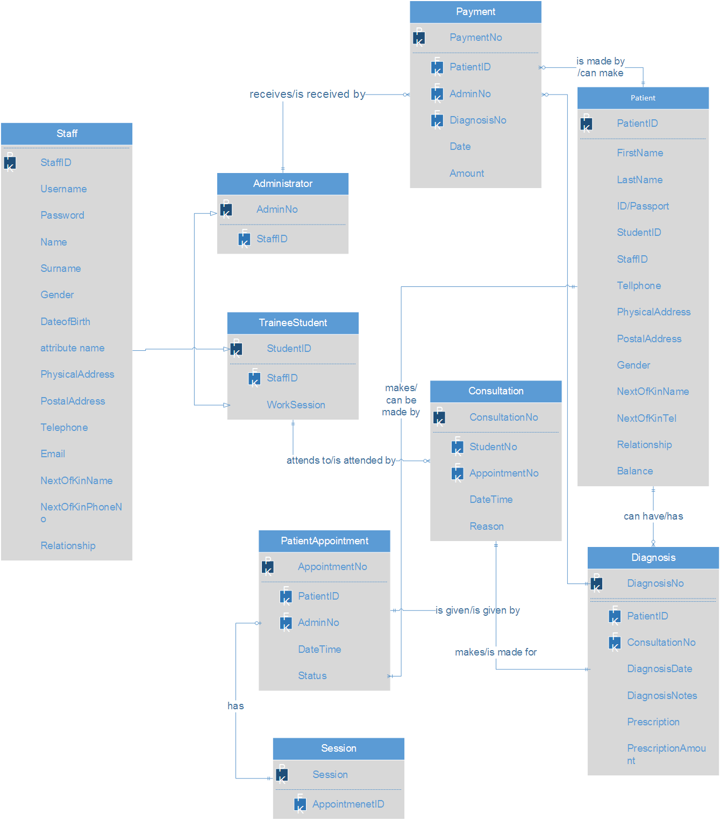
ENTITY RELATIONSHIP DIAGRAM

Slide 7
BENEFITS OF THE SYSTEM
Improve patient data security
Change manual patient record filling to an information system
Advance patient record keeping
Improve decision making
Improve patient statistics capturing
Advance patient booking system

Slide 8
PROJECT HIGHLIGHTS AND ACHIEVEMENTS
Team work: Communication, listening and understanding brings about a successful project.
Achieving our main system goal is to eliminate manual systems.
Priscillar the administrator is impressed about the whole system.
Combining everything we learnt from ISTN211 , 212 with our third year ISTN modules in order to achieve a working system.
All members learnt the basics of coding.
Project was developed and carried out in a truly collaborative manner.

Slide 9
PROJECT LOWLIGHTS AND LESSONS LEARNT
Lack of time management
Project scope was too big which forced us to review our actual plan and design
Lack of proper planning

Slide 10
WHERE TO FROM HERE?
As Dynamic Systems Practitioners we believe that our client will be able to use the system as it meets most of the functional requirements needed to computerise the appointment booking, registration of patients and trainee students. It will also take care

Slide 11
GROUP MEMBERS
213530876- Zanele Nkosi
214516138- Nothando Mkhwanazi
214523369- Candice Gumede
215016957- Lindani Mabaso
215024323- Senzosenkosi Shezi
215079932- Njabulo Hlophe

